Slide 1
ETHICS LAW FOR COUNTY COMMISSIONERS
NM Association of Counties | December 8, 2020
STATE ETHICS COMMISSION
Notes:
JDF

Slide 2
OUTLINE
Introduction
Ethics Laws for County Government
Government Conduct Rules
Procurement
Employment
Anti-donation Clause
Resources
Notes:
JDF

Slide 3
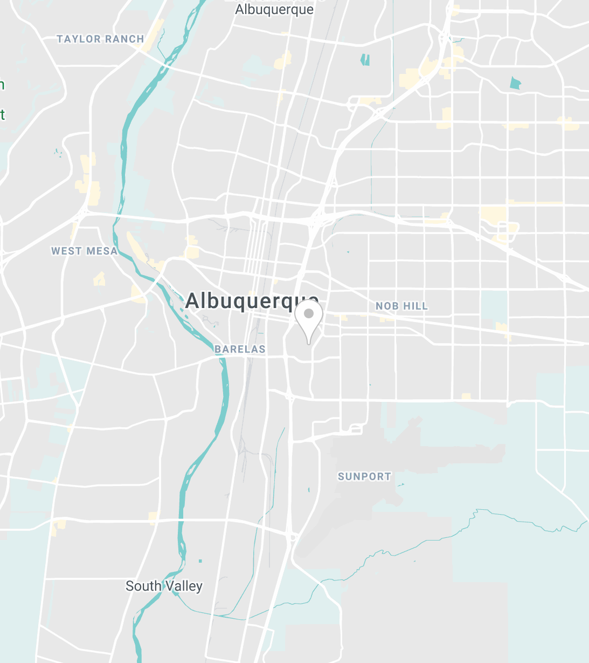
STATE ETHICS COMMISSION
7 COMMISSIONERS
5 STAFF MEMBERS
TYPE TEXT
POWERS AND RESPONSIBILITIES SPECIFIC TO COUNTY GOVERNMENT:
PROVIDE TRAINING ON ETHICS LAWS
PROVIDE ADVICE TO LOCAL OFFICIALS/EMPLOYEES
ENFORCE GOVERNMENTAL CONDUCT ACT
Notes:
JDF

Slide 4
COMMISSIONERS
Chair: Judge William F. Lang (ret.)​​​​ ​​
Hon. Garrey Carruthers
Dr. Judy Villanueva
Jeffrey L. Baker
Ronald Solimon
Stuart M. Bluestone
Frances F. Williams
Notes:
JDF

Slide 5
COMMISSION STAFF MEMBERS
Executive Director: Jeremy D. Farris​ ​​
Finance Director: Wendy George
General Counsel: Walker Boyd
Communications Director: Sonny C. Haquani
Deputy General Counsel: Rebecca Branch
Notes:
JDF

Slide 6
TRAINING
§ 10-16-13.1
“The state ethics commission shall advise and seek to educate all persons required to perform duties under the Governmental Conduct Act of those duties. This includes advising all those persons at least annually of that act's ethical principles.”
§ 10-16G-5(C)(5)
“Beginning January 1, 2020, the commission may . . . offer annual ethics training to public officials, public employees, government contractors, lobbyists and other interested persons.”
Notes:
JDF

Slide 7
ADVICE
§ 10-16G-8
The Commission may issue advisory opinions on matters related to ethics. ​
Notes:
WB

Slide 8
ENFORCEMENT
§ 10-16-18(B)
“The state ethics commission may institute a civil action in district court or refer a matter to the attorney general or a district attorney to institute a civil action in district court if a violation has occurred or to prevent a violation of any provision of the Governmental Conduct Act. Relief may include a permanent or temporary injunction, a restraining order or any other appropriate order, including an order for a civil penalty of two hundred fifty dollars ($250) for each violation not to exceed five thousand dollars ($5,000).”
§ 10-16-13.1(B)
“The state ethics commission shall seek first to ensure voluntary compliance with the provisions of the Governmental Conduct Act. A person who violates that act unintentionally or for good cause shall be given ten days' notice to correct the matter. Referrals for civil enforcement of that act shall be pursued only after efforts to secure voluntary compliance with that act have failed.”
Notes:
JDF

Slide 9
ETHICS LAWS FOR COUNTY GOVERNMENT
Government Conduct, Procurement, Employment, and Anti-donation Rules​
Notes:
JDF

Slide 10
TWO ORGANIZING IDEAS
Government Belongs to the Public
The property, powers, and prerogatives of government office belong to and are for the benefit of the public, not the officials.
Disclosure Protects Representative Government
Disclosure of who and what might influence an official allows constituents to check that officials use the powers of their office for the benefit of the public.
Notes:
JDF

Slide 11
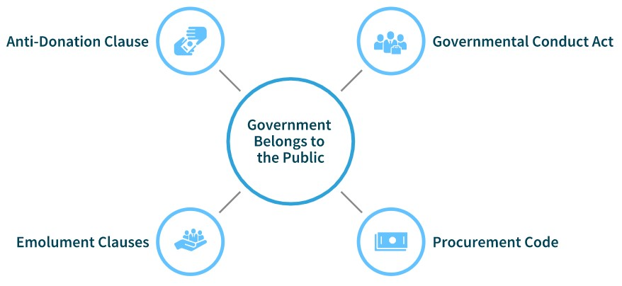
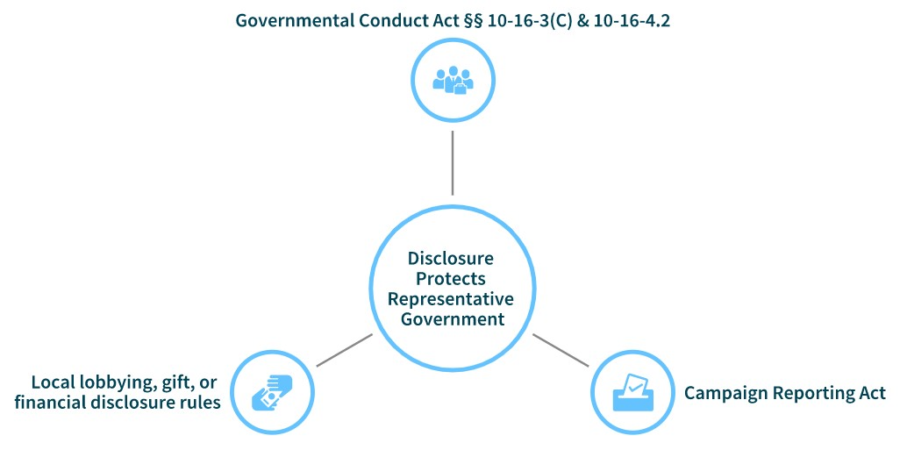
TWO ORGANIZING IDEAS
11
Notes:
JDF

Slide 12
GOVERNMENT CONDUCT RULES
Sources of law and provisions relevant to county government​
Notes:
WB

Slide 13
SOURCES OF RULES
Governmental Conduct Act
County Ordinances
Criminal Code
Bribery and Kickback Provisions
Notes:
WB

Slide 14
OVERVIEW
Ethical principles of public service and prohibited acts​
SELECTED GOVERNMENTAL CONDUCT ACT RULES RELEVANT TO COUNTY GOVERNMENT
Political activities​
Official act for personal financial interest​
Honoraria​
Business sales to employees​

Slide 15
ETHICAL PRINCIPLES OF PUBLIC SERVICE; PROHIBITED ACTS
§ 10-16-3(A)
§ 10-16-3(C)
Under the Governmental Conduct Act, a government position is a public trust. The powers and resources of public office may be used “only to advance the public interest and not to obtain personal benefits or pursue private interests.”
“Full disclosure of real or potential conflicts of interest shall be a guiding principle for determining appropriate conduct.”
§ 10-16-3(D)
It is a felony to knowingly and willfully request or receive any money, thing of value or promise thereof conditioned upon or given in exchange for promised performance of an official act.
§ 10-16-3(B)
The “high responsibilities of public service” must be discharged ethically and with integrity.
Notes:
WB

Slide 16
POLITICAL ACTIVITIES
The Governmental Conduct Act prohibits:​
Coercion
Directly or indirectly coercing or attempting to coerce another public officer or employee to pay, lend or contribute anything of value to a party, committee, organization, agency or person for a political purpose;
Threats
threatening to deny a promotion or pay increase to an employee who does or does not vote for certain candidates, requiring an employee to contribute a percentage of the employee's pay to a political fund, influencing a subordinate employee to purchase a ticket to a political fundraising dinner or similar event, advising an employee to take part in political activity or similar activities;
Unauthorized use of public property
use of state agency or local government agency property for other than authorized purposes.
Notes:
WB

Slide 17
OFFICIAL ACT FOR PERSONAL FINANCIAL INTEREST​
§ 10-16-4
Primary Purpose
The Governmental Conduct Act prohibits official acts whose primary purpose is to directly enhance a public officer or employee’s financial interest or financial position.
Personal Benefit
A public officer or employee is disqualified from taking an action that may benefit a financial interest held by the officer or employee, unless the benefits to the public are greater than the benefits to the employee.
Conflicting Financial Interests
No public officer during the term for which elected and no public employee during the period of employment shall acquire a financial interest when the public officer or employee believes or should have reason to believe that the new financial interest will be directly affected by the officer's or employee's official act.
Notes:
WB

Slide 18
HONORARIA
Accepting or Requesting
No legislator, public officer or employee may request or receive an honorarium for a speech or service rendered that relates to the performance of public duties.
Definition
§ 10-16-4.1
“Honorarium” means payment of money, or any other thing of value in excess of one hundred dollars ($100), but does not include reasonable reimbursement for meals, lodging or actual travel expenses incurred in making the speech or rendering the service, or payment or compensation for services rendered in the normal course of a private business pursuit.
Notes:
WB

Slide 19
BUSINESS SALES TO EMPLOYEES​
The Governmental Conduct Act may prohibit the sale of goods or services to:
supervised employees, unless the supervised employee initiates the sale; and​
a person over whom the public officer or employee has regulatory authority (includes commissions and employment).
§ 10-16-13.2.​
Notes:
WB
A. A public officer or employee shall not sell, offer to sell, coerce the sale of or be a party to a transaction to sell goods, services, construction or items of tangible personal property directly or indirectly through the public officer's or employee's family or a business in which the public officer or employee has a substantial interest, to an employee supervised by the public officer or employee. A public officer or employee shall not receive a commission or shall not profit from the sale or a transaction to sell goods, services, construction or items of tangible personal property to an employee supervised by the public officer or employee. The provisions of this subsection shall not apply if the supervised employee initiates the sale. It is not a violation of this subsection if a public officer or employee, in good faith, is not aware that the employee to whom the goods, services, construction or items of tangible personal property are being sold is under the supervision of the public officer or employee.

Slide 20
Connie Commissioner recently won an election to serve as a county commissioner for Blackacre County. Next week, the Commission will vote on whether to allow land zoned for single family residences to be converted to permit the construction of multi-family housing and retail by Donald Developer, LLC. Donald Developer, LLC is the seller in a transaction Connie brokered before the election. But the closing date happens to be the day before next week’s Commission meeting.​
CASE STUDY: REAL ESTATE COMMISSIONS​
What should Connie do? Recuse from the Commission vote? Delay closing?
Notes:
WB
What are some facts that are missing? Is there an “understanding” between D and C?
Let’s talk about the date of closing. If closing happens the day before the meeting, does that eliminate any conflict of interest?
Does anything change if the closing date is moved to after the meeting?

Slide 21
PROCUREMENT
Sources of rules, overview and scope of Procurement Code requirements, and selected ethics provisions​
Notes:
JDF

Slide 22
PROCUREMENT CODE: OVERVIEW AND SCOPE​
§ 13-1-29(C)
“The purposes of the Procurement Code are to provide for the fair and equitable treatment of all persons involved in public procurement, to maximize the purchasing value of public funds and to provide safeguards for maintaining a procurement system of quality and integrity.”
§ 13-1-30(A)
The procurement code applies “to every expenditure by state agencies and local public bodies for the procurement of items of tangible personal property, services and construction.”
Notes:
JDF

Slide 23
WHO HOLDS THE CHECKBOOK?​
Chief procurement officers. Only certified chief procurement officers may do the following:
make determinations, including determinations regarding exemptions, pursuant to the Procurement Code;
issue purchase orders and authorize small purchases pursuant to the Procurement Code; and
approve procurement pursuant to the Procurement Code. See § 13-1-95.2(E)
Notes:
JDF

Slide 24
EXCEPTIONS FROM THE PROCUREMENT CODE​
Purchases of tangible items from other government agencies (state and local)
Prepayment for conferences, magazine subscriptions, etc.​
Jail operation contracts​
Books, periodicals, etc. from copyright holder (e.g., Albuquerque Journal)​
Advertising
Purchases of services provided by disabled workers (State Use Act)​
Travel, meals and lodging​
Public school transportation services​
§ 13-1-98 contains more exceptions​
Notes:
JDF

Slide 25
EXCEPTION FOR SMALL PURCHASES​
§ 13-1-125
A) A central purchasing office shall procure services, construction or items of tangible personal property having a value not exceeding sixty thousand dollars ($60,000), excluding applicable state and local gross receipts taxes, in accordance with the applicable small purchase rules adopted by the secretary, a local public body or a central purchasing office that has the authority to issue rules.​
B) Notwithstanding the requirements of Subsection A of this section, a central purchasing office may procure professional services having a value not exceeding sixty thousand dollars ($60,000), excluding applicable state and local gross receipts taxes, except for the services of landscape architects or surveyors for state public works projects or local public works projects, in accordance with professional services procurement rules promulgated by the general services department or a central purchasing office with the authority to issue rules.​
C) Notwithstanding the requirements of Subsection A of this section, a state agency or a local public body may procure services, construction or items of tangible personal property having a value not exceeding twenty thousand dollars ($20,000), excluding applicable state and local gross receipts taxes, by issuing a direct purchase order to a contractor based upon the best obtainable price.​
D) Procurement requirements shall not be artificially divided so as to constitute a small purchase under this section.
Notes:
JDF

Slide 26
CASE STUDY: LEGAL SERVICES
Legal Eagles, LLC has provided contract legal services (usually advice and personnel issues) for Blackacre County over the past few years. But the county has just been hit with several lawsuits, and Legal Eagles has prepared a litigation budget for each case. The total budget estimate is $500,000 over 5 years. But because cases move slowly, the law firm estimates that it will only bill $50,000 in the first year.​​
Does the county need to procure legal services to defend against these suits through a request for proposals?
Notes:
JDF

Slide 27
SOURCES OF RULES​
Procurement Code​
Governmental Conduct Act​
County Ordinance / Other local rules​
Notes:
JDF

Slide 28
SELECTED ETHICS RULES RELATING TO PROCUREMENTS​
Financial interests in offers​
Involvement by offeror employees in evaluation of bids or proposals​
Confidential information​
Contracts with former officers or employees​
Notes:
JDF

Slide 29
FINANCIAL INTERESTS IN OFFERS​
§ 13-1-190:
​…it is unlawful for any state agency or local public body employee, as defined in the Procurement Code, to participate directly or indirectly in a procurement when the employee knows that the employee or any member of the employee's immediate family has a financial interest in the business seeking or obtaining a contract.​​
§ 10-16-7:​
A) A state agency shall not enter into a contract with a public officer or employee of the state, with the family of the public officer or employee or with a business in which the public officer or employee or the family of the public officer or employee has a substantial interest unless the public officer or employee has disclosed through public notice the public officer's or employee's substantial interest and unless the contract is awarded pursuant to a competitive process; provided that this section does not apply to a contract of official employment with the state. A person negotiating or executing a contract on behalf of a state agency shall exercise due diligence to ensure compliance with the provisions of this section.​
B) Unless a public officer or employee has disclosed the public officer's or employee's substantial interest through public notice and unless a contract is awarded pursuant to a competitive process, a local government agency shall not enter into a contract with a public officer or employee of that local government agency, with the family of the public officer or employee or with a business in which the public officer or employee or the family of the public officer or employee has a substantial interest.​
C) Subsection B of this section does not apply to a contract of official employment with a political subdivision. A person negotiating or executing a contract on behalf of a local government agency shall exercise due diligence to ensure compliance with the provisions of this section.
Notes:
JDF

Slide 30
INVOLVEMENT IN EVALUATION OF BIDS OR PROPOSALS​
§ 13-1-193: It is unlawful for any state agency or local public body employee who is participating directly or indirectly in the procurement process to become or to be, while such an employee, the employee of any person or business contracting with the governmental body by whom the employee is employed.​​
§ 10-16-4.3: It is unlawful for a state agency employee or local government agency employee who is participating directly or indirectly in the contracting process to become or to be, while such an employee, the employee of any person or business contracting with the governmental body by whom the employee is employed.​​
§ 10-16-13: No state agency or local government agency shall accept a bid or proposal from a person who directly participated in the preparation of specifications, qualifications or evaluation criteria on which the specific competitive bid or proposal was based. A person accepting a bid or proposal on behalf of a state agency or local government agency shall exercise due diligence to ensure compliance with this section.
Notes:
JDF

Slide 31
CONFIDENTIAL INFORMATION​
§ 13-1-195: It is unlawful for any state agency or local public body employee or former employee knowingly to use confidential information for actual or anticipated personal gain or for the actual or anticipated personal gain of any other person.​​
§ 10-16-6: No legislator or public officer or employee shall use or disclose confidential information acquired by virtue of the legislator's or public officer's or employee's position with a state agency or local government agency for the legislator's, public officer's or employee's or another's private gain.
Notes:
JDF

Slide 32
CASE STUDY – OUT-OF-TOWNERS NEED NOT APPLY​
Bootheel county issues a request for proposals for landscaping services at the county government headquarters. Several sealed proposals are received from companies based in Tucson. No Bootheel county companies apply. Cody Commissioner knows several top-quality landscaping companies based in Bootheel, and would hate to see the landscaping contract go to an Arizona company. Especially since the Arizona companies are asking top dollar! Cody decides to tell his buddies in the landscaping business about the Arizona firms’ proposals. He figures that the worst that can happen is that the county gets a better deal from a local company.
WHAT'S THE WORST THAT COULD HAPPEN?
Notes:
JDF

Slide 33
CONTRACTS WITH FORMER OFFICERS OR EMPLOYEES​
§ 10-16-8:​​
C. A local government agency shall not enter into a contract with, or take any action favorably affecting, any person or business that is:​
(1) represented personally in the matter by a person who has been a public officer or employee of that local government agency within the preceding year if the value of the contract or action is in excess of one thousand dollars ($1,000) and the contract is a direct result of an official act by the public officer or employee; or​
(2) assisted in the transaction by a former public officer or employee of that political subdivision of the state whose official act, while in employment with that political subdivision of the state, directly resulted in the agency's making that contract or taking that action.​
D. For a period of one year after leaving government service or employment, a former public officer or employee shall not represent for pay a person before the state agency or local government agency at which the former public officer or employee served or worked.​​
Notes:
JDF

Slide 34
EMPLOYMENT​
Notes:
WB

Slide 35
OUTSIDE EMPLOYMENT​
§ 10-16-4.2:
“A public officer or employee shall disclose in writing to the officer's or employee's respective office or employer all employment engaged in by the officer or employee other than the employment with or service to a state agency or local government agency.”
Notes:
WB

Slide 36
NEPOTISM​
§ 10-1-10: It shall hereafter be unlawful for any person elected or appointed to any public office or position under the laws of this state or by virtue of any ordinance of any municipality thereof, to employ as clerk, deputy or assistant, in such office or position, whose compensation is to be paid out of public funds, any persons related by consanguinity or affinity within the third degree to the person giving such employment, unless such employment shall first be approved by the officer, board, council or commission, whose duty it is to approve the bond of the person giving such employment; provided, that this act shall not apply where the compensation of such clerk, deputy or assistant shall be at the rate of $600 or less a year, nor shall it apply to persons employed as teachers in the public schools.
Notes:
WB

Slide 37
HARASSMENT / HOSTILE WORK ENVIRONMENT​
Short rule:
don’t engage in harassment and do not create a hostile work environment for the employees you supervise!​​
When in doubt, consult with HR / legal.
Notes:
WB

Slide 38
ANTI-DONATION​
Notes:
WB

Slide 39
ANTI-DONATION
N.M. Const., Article IX, Section 14​
“Neither the state nor any county, school district or municipality, except as otherwise provided in this constitution, shall directly or indirectly lend or pledge its credit or make any donation to or in aid of any person, association or public or private corporation or in aid of any private enterprise for the construction of any railroad except as provided in Subsections A through G of this section.”
Notes:
WB

Slide 40
COUNTY ETHICS ORDINANCES
Check your local law!
Bernalillo, Doña Ana, Sandoval, and Santa Fe counties each have an ethics ordinance that may impose additional rules on procurements, conflict of interest rules, etc.
Model Code of Ethics Coming Soon
The State Ethics Commission will soon promulgate its model code of ethics which county governments may adopt.
Notes:
WB

Slide 41
BRIBE AND KICKBACK STATUTES​
Numerous criminal prohibitions in state and federal law.​
Examples: demanding illegal fees (§ 30-23-1), paying for or receiving public money for services not rendered (§ 30-23-2), making a false claim for payment (§ 30-23-3), receiving money from a public contract (§ 30-23-6).
Seek advice on a transaction from an attorney if you question whether a transaction is legal.
Notes:
WB

Slide 42
RESOURCES
Notes:
WB

Slide 43
ADVISORY OPINIONS​
Formal Advisory Opinions
Formal advisory opinions may only be requested by a public official, public employee, candidate, person subject to the Campaign Reporting Act, government contractor, lobbyist or lobbyist's employer. Because county officials and employees are not subject to State Ethics Commission complaint jurisdiction, they cannot request formal advisory opinions.
Informal Advisory Opinions
Informal advisory opinions can be requested by county officials and employees, since they are subject to the Governmental Conduct Act. See also 1.8.1.9 NMAC
Must be requested in writing.
Requests for advisory opinions are confidential by law.​​
.
For more information and to request an opinion, email: ethics.commission@state.nm.us
Notes:
WB

Slide 44
GOVERNMENT CONDUCT HANDBOOK​
New Mexico Attorney General’s Office published a handbook for Governmental Conduct Act compliance in 2015.​​
State Ethics Commission staff and contractors are working on updating the handbook. Estimated date of publication mid-2021.
Notes:
WB

Slide 45
QUESTIONS AND COMMENTS
CONNECT WITH THE SEC
www.sec.state.nm.us
ethics.commission@state.nm.us
@NMETHICS
Notes:
WB

