Slide 1
ETHICS LAW & MUNICIPAL GOVERNMENT
New Mexico Municipal Attorneys Association | Winter Meeting and Seminar
December 2, 2021 (11:15am) | Albuquerque
Jeremy Farris, Executive Director, State Ethics Commission
STATE ETHICS COMMISSION

Slide 2
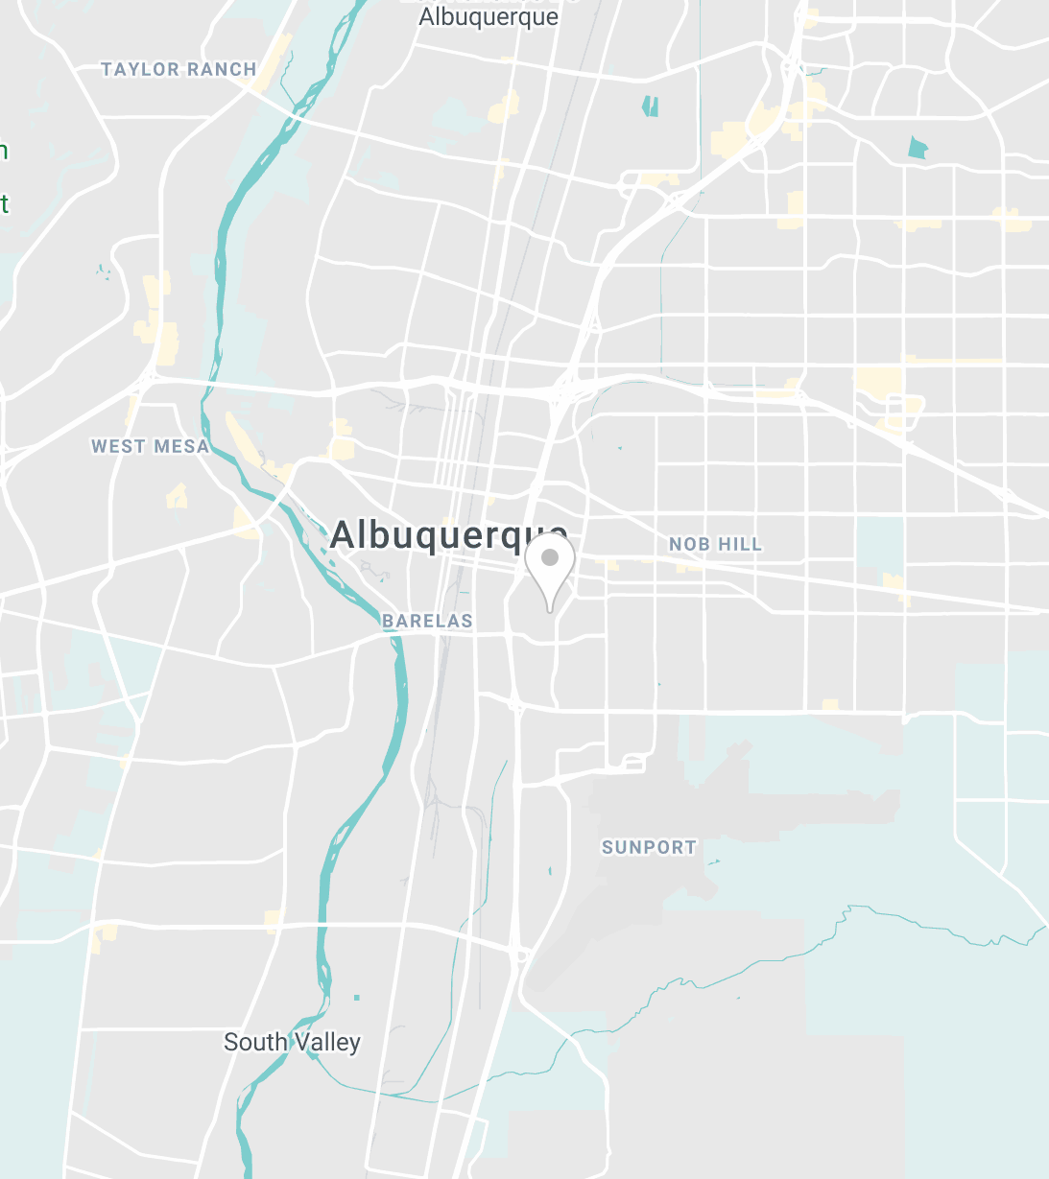
STATE ETHICS COMMISSION
7 COMMISSIONERS
• Hon. William Lang (ABQ) • Hon. Garrey Carruthers (LC)
• Jeffrey Baker (ABQ) • Hon. Celia Foy Castillo (SF)
• Stuart Bluestone (SF) • Dr. Judy Villanueva (Carlsbad)
• Ronald Solimon (ABQ)
TYPE TEXT
POWERS AND RESPONSIBILITIES SPECIFIC TO LOCAL GOVERNMENT:
• PROVIDE TRAINING ON ETHICS LAWS
• PROVIDE ADVICE TO LOCAL OFFICIALS/EMPLOYEES
• ENFORCE APPLICABLE ETHICS LAWS

Slide 3
COMMISSION POWERS & DUTIES (1/2)
Quasi-Judicial Functions:
Adjudicate administrative complaints and issue advisory opinions​ ​ Adjudicate administrative complaints alleging violations of the laws under the SEC’s jurisdiction. Complainant v. Respondent (State Ethics Comm’n) ​
​
Issue formal and informal (letter) advisory opinions on laws that Commission oversees.
Executive Functions: ​
Civil enforcement actions,
recommendations to Legislature and Governor, ​and trainings​
​
Investigate alleged violations and initiate civil litigation in state courts to enforce selected provisions of ethics statutes. State Ethics Comm’n v. Defendant (2nd Jud. Dist. Ct.)​
​
Provide recommendations on amendments to New Mexico’s ethics laws.
Offer ethics trainings and guides, and “other duties as assigned” (e.g., redistricting committee appointments)
Legislative Functions:
Delegated rulemaking powers (NMAC)​ ​
Promulgate rules of procedure for administrative adjudication. (1.8.3 NMAC)
Promulgate proposed code of ethics (1.8.4 NMAC)
Notes:
Only via lobbyist employer is only way a municipality would be within the Commission’s personal jurisdiction.

Slide 4
COMMISSION POWERS & DUTIES (2/2)
Personal Jurisdiction (as an adjudicatory body)
All Executive Officials and Legislators​
All Executive and Legislative Employees ​ (~17,000 in filled positions)​
Lobbyists and lobbyists’ employers ​ (725)​
Candidates and entities subject to Campaign Reporting Act ​ (700)​
State government contractors and seekers of state government contracts ​ (~40,000 active outside suppliers)
Subject-Matter Jurisdiction and Civil Enforcement Authority​
​
Campaign Reporting Act​
Financial Disclosure Act​
Gift Act​
Lobbyist Regulation Act​†
Voter Action Act​
Governmental Conduct Act*
Procurement Code​†
State Ethics Commission Act​
Article 9, Section 14 of the Constitution (Anti-Donation Clause)*
Revised Uniform Law on Notarial Acts (2022)
Notes:
The Procurement Code does not apply to municipalities having adopted home rule charters and having enacted their own purchasing ordinances. 13-1-98(K).
The definition of “election” in the Campaign Reporting Act excludes municipal elections. See NMSA 1978, s 1-19-26(K).
The definition of “public officer or employee” in the Financial Disclosure Act covers only persons “elected to, appointed to, or hired for any state office who receives compensation in the form of salary or is eligible for per diem or mileage, but excludes legislators or judges.” 10-16A-2(F). Candidates for the legislature and legislators are separately required to file.
Lobbyist Regulation Act: “Each . . . lobbyist’s employer who makes or incurs expenditures or makes political contributions for the benefit of or in opposition to a state legislator or candidate for the state legislature, a state public officer or candidate for state public office, a board or commission member or state employee who is involved in an official action affecting the lobbyist's employer or in support of or in opposition to a ballot issue or pending legislation or official action shall file an expenditure report with the secretary of state using an electronic reporting system approved by the secretary of state in accordance with Section 2-11-7 NMSA 1978.” 2-11-6(A). To tease this out: Lobbyist means an individual who is compensated to lobby. Lobbying means attempting to influence an action by the legislature, or the governor, or the action or nonaction of a state official, state agency, or state board acting in a rulemaking proceeding.
“Lobbyist’s employer” means person whose interests are being represented and by whom a lobbyist Is directly or indirectly retained, compensated or employed; and “person” means an individual, partnership, association, committee, federal, state or local governmental entity or agency, however constituted, public or private corporation or any other organization or group of persons who are voluntarily acting in concert;

Slide 5
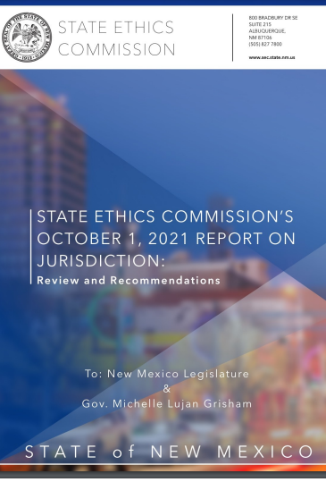
Commission’s Recommendations on its Quasi-judicial Functions: October 1, 2021
Recommend no changes that would include officials and employees of local governments into the personal jurisdiction of the Commission as an adjudicatory body
Recommend including state-agency entities (and not only their officials and employees) within the Commission’s personal jurisdiction
Recommend expanding subject-matter jurisdiction to include other ethical provisions of the New Mexico Constitution—e.g., the legislative interests in contracts clause, extra compensation clause, emoluments clause.
Recommend allowing local officials and employees to request Commission advisory opinions
*Special thanks to the Municipal League for helping to coordinate the Commission’s survey of municipal views on these questions.

Slide 6
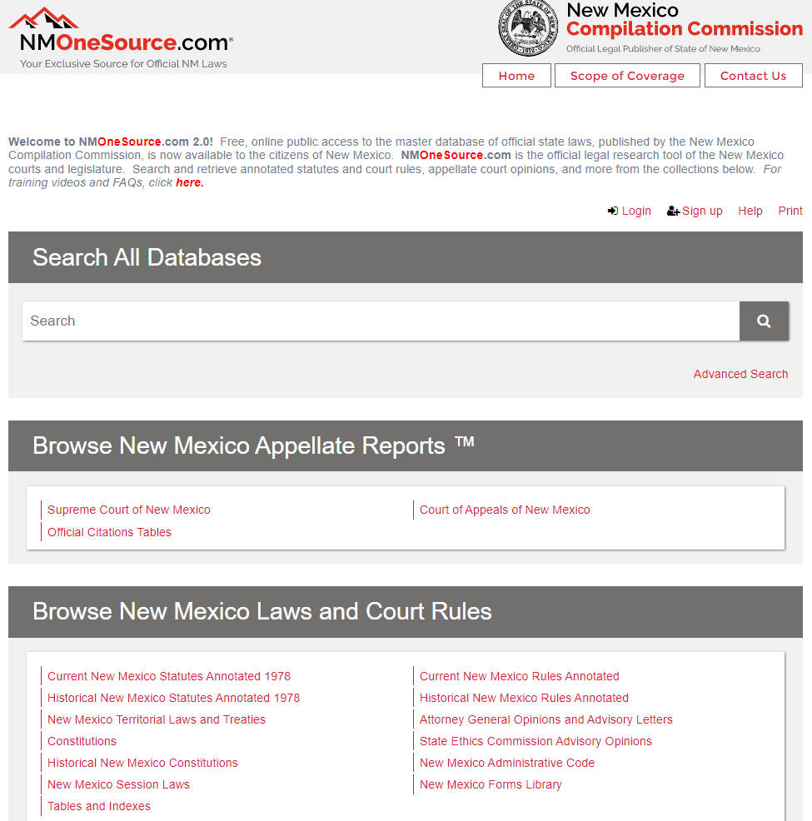
ADVISORY OPINIONS
Advisory opinions. § 10-16G-8. May only be requested by person subject to the Commission’s personal jurisdiction.
Advisory letters. 1.8.1.9(B) NMAC. May be requested by municipal officials and employees, because subject to GCA.
Must be requested in writing: ethics.commission@state.nm.us
Requests for advisory opinions are confidential by law.​​

Slide 7
TWO ORGANIZING IDEAS
Government
1 belongs to the public
The property, powers, and prerogatives of government office belong to and are for the benefit of the public only, not the officials. See NMSA 1978, § 10-16-3(A).
Nota bene: State v. Gutierrez, et al., No. S-1-SC-38367, consolidated with No. S-1-SC-38368 (Oral arguments: Jan. 14, 2022) (considering constitutionality of criminal charges for violations of subsections 10-16-3(A)-(C)); see also § 10-16-3(A) (“The legislator or public officer or employee shall use the powers and resources of public office only to advance the public interest and not to obtain personal benefits or pursue private interests.”).

Slide 8
TWO ORGANIZING IDEAS
Disclosure ensures
2 representative government
Disclosure of who and what might influence an elected official allows constituents to check that the uses of government office are for the benefit of the public and not the official.
Disclosure helps to justify commonplace departures from the ideal theory of representation that representatives reflect the voices of the constituent members of their districts.

Slide 9
THESE TWO IDEAS ORGANIZE NM’S ETHICS LAWS
Bribery and Solicitation Clause, N.M. Const., Art. IV, § 39
Interest in Contracts Clause, N.M. Const., Art. IV, § 28
GOVERNMENT BELONGS TO THE PUBLIC
Emoluments Clauses, N.M. Const., Art. IV, § 28; Art. X, § 1
Anti-Donation Clause, N.M. Const., Art. IX, § 14 (*)
Governmental Conduct Act (*)
Lobbyist Regulation Act (†)
Procurement Code (†)
Gift Act
Campaign Reporting Act
Financial Disclosure Act
DISCLOSURE ENSURES REPRESENTATIVE GOVERNMENT
Governmental Conduct Act, §§ 10-16-3(C) & 10-16-4.2 (*)
Procurement Code, § 13-1-191.1 (†)

Slide 10
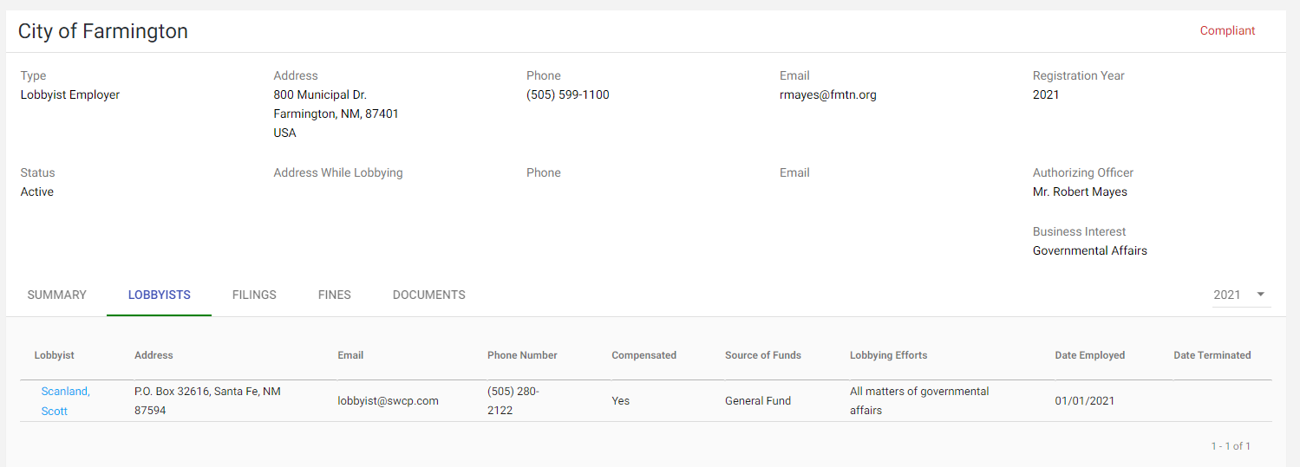
LOBBYIST REGULATION ACT
§ 2-11-6: filing requirements: expenditure reports or statements of no activity, to be filed either by the lobbyist or lobbyist employer (so, make sure your lobbyist is filing appropriate disclosures with the SOS).
§ 2-11-8: prohibition on contingent fees: lobbyist employers cannot condition a lobbyist’s compensation on the outcome of lobbying activities before legislative branch or with respect to a gubernatorial veto

Slide 11
GOVERNMENTAL CONDUCT RULES
Selected provisions of the Governmental Conduct Act relevant to municipal government​

Slide 12
Prohibited Political Activities
Coercing others to make contributions (§ 10-16-3.1(A) & (B)):
Municipal official or employee cannot
coerce another public officer or employee to make a contribution to a candidate, committee, or other person for a political purpose;
threaten to deny a pay increase to employee depending on how they vote;
require an employee to contribute percentage of their pay to a political fund; or
influence a subordinate employee to purchase a ticket to a political fundraising dinner.
Using municipal property for political purpose
(§ 10-16-3.1(C)):
Municipal official or employee cannot use municipal property, or allow its use, “for other than authorized purposes”– i.e., as an in-kind contribution to a candidate or political campaign.
*This provision also prohibits more mundane unauthorized uses of municipal property for a personal benefit. (e.g., using a municipal truck for a personal vacation)
Note: These provisions prevent public officials from using the public powers and resources at their disposal to finance their own campaigns or to support their political party. The statutory provisions also protect core First Amendment rights of public employees with respect to their decisions about voting and political contributions. As such, these laws keep separate the government, as an entity, and the political parties that vie for leadership positions in government.
Notes:
Examples of 3.1©: copying, municipal office space, municipal vehicles, municipal IT equipment. etc.

Slide 13
Prohibited Sales
Sales to employees (§ 10-16-13.2(A)):
Municipal official or employee cannot sell goods, services, or construction to an employee, unless the employee initiates the sale.
Sales to persons under regulatory authority (§ 10-16-13.2(B)-(C)):
Municipal official or employee cannot sell goods, services, or construction to a person over whom they have regulatory authority.
Notes:
.

Slide 14
Governmental Conduct Act & Procurement
Contracts involving public officials or employees (§ 10-16-7(B))
No contract between municipality and a public officer or employee, their family, or a business in which they have > 20% ownership interest, unless:
The public officer or employee disclosed their interest; and
The contract is awarded pursuant to a competitive process (RFP or ITB)
*Does not apply to employment contracts with municipality
Prohibited bidding (§ 10-16-13):
Municipality cannot accept a bid or proposal from a person who participated in the preparation of the specifications, qualifications or evaluation criteria on which the bid or proposal was based.
Note: These GCA provisions apply even where the Procurement Code does not -- i.e., to home rule municipalities with their own procurement ordinances. These rules, and rules about contemporaneous outside employment, severely constrain the ability of a municipal official or employee to be on both sides of a transaction involving municipal funds.

Slide 15
Revolving Door
Permanent ban on representation (§ 10-16-8(B))
A former official or employee cannot represent a person with the person’s dealings with “the government” on a matter in which the former official or employee “participated personally and substantially” while a public official or employee
Cooling-off period (§ 10-16-8(D))
For a period of one year after leaving government service or employment, a former public official or employee shall not represent “for pay” a person before the local government agency at which the former public official or employee worked
Ban on revolving door contracts (§ 10-16-8(C))
Municipality cannot enter contract with a business who is represented by a person who, within the preceding year, was a municipal official or employee if:
The contract is for more than $1000; and
The contract is a “direct result of an official act” of the former municipal official or employee
Nota bene: State Ethics Commission v. Vargas & Double Eagle Real Estate LLC, D-202-CV-2021-06201 (2d Jud. Dist. Ct. Oct. 27, 2021) (civil action to enforce GCA revolving door provisions in subsections 10-16-8(B) and (D), pursuing civil fines, corporate vicarious liability and disgorgement).

Slide 16
Contemporaneous Outside Employment
Disclosure of outside employment (§ 10-16-4.2):
Municipal officer or employee can accept outside employment that does not relate to the performance of their official duties, but they must “disclose in writing” the outside employment to their respective municipal office.
Honoraria prohibited (§ 10-16-4.1):
Municipal officer or employee cannot request or receive an honorarium for a speech or a service rendered that relates to the performance of their public duties. An honorarium is cash or any thing of value greater than $100, but excludes reimbursement for personal costs incurred in making the speech or rendering the service.
Prohibited employment with contracting businesses (§ 10-16-4.3):
Municipal officer or employee who is participating in municipal contracting process with a business cannot, while a municipal employee, accept outside employment with the business contracting with the municipality.
See also Procurement Code, § 13-1-193.
Prohibited employment with regulated businesses (§ 10-16-13.2(D)):
Municipal officer or employee cannot, while a municipal officer or employee, accept an offer of employment or independent contract from a business over whom the municipal officer or employee has regulatory authority.
Also about prohibited employment: the old nepotism statute, § 10-1-10 (1925), prevents a municipal official or employee from employing a deputy, clerk or assistant who is a relative within the third degree (i.e., first cousins or closer), unless first approved by a higher officer, board, or council.

Slide 17
Duties at a High Level of Generality
Prohibited use of public powers (§ 10-16-3(A)):
Municipal officer or employee “shall use the powers and resources of public office only to advance the public interest and not to obtain personal benefits or pursue private interests”
*State v. Gutierrez, 2020-NMCA-045 (holding that this provision survived constitutional challenge)
Disqualification for conflicts of interest (§ 10-16-4(B)):
Municipal official or employee is disqualified and must recuse from taking any official act directly benefiting their financial interest, where the benefit to their financial interest is proportionately greater than the benefit to the general public.
No official acts to enhance financial interest (§ 10-16-4(A)):
Municipal officer or employee shall not take an official act for the primary purpose of directly enhancing their financial interest or financial position
*The knowing and willful violation of this section is a fourth degree felony.
Note: the Governmental Conduct Act advances the main principle that the powers, prerogatives, and property of public office be exercised only for the public benefit by imposing duties both (1) at a high specificity (like prohibiting certain sales) and (2) at a high level of generality (like prohibiting any official act taken to promote one’s own financial interest).

Slide 18
PROCUREMENT
Quick overview of Procurement Code and selected ethics provisions​
Notes:
JDF

Slide 19
THE PROCUREMENT CODE IN ONE SLIDE​
(1) The main rule: All procurement is achieved through competitive sealed bids or proposals. (§ 13-1-102). (2) But there are many exemptions and exceptions:
Purchases of tangible items from other government agencies (state and local)
Prepayment for conferences, magazine subscriptions, etc.​
Jail and hospital operation contracts​
Procurements under existing contracts (e.g., GSA or statewide price agreements)
Advertising
Purchases of services provided by disabled workers (State Use Act)​
Travel, meals and lodging​
Public school transportation services​
Small purchases ($60,000 for professional services; $20,000 for other services and goods)
(3) And even where there are exceptions, other purchasing rules still apply.

Slide 20
The Procurement Code as a governmental ethics statute
And §§ 13-1-190 to -195 are the core, traditional ethics provisions of the Code
§ 13-1-190(A)
A government employee cannot participate directly or indirectly in a procurement when the employee knows that they or their immediate family member has a financial interest in the business seeking to obtain a contract.
(Subject to a waiver under § 194)
§ 13-1-193
A government employee who is participating directly or indirectly in the procurement process cannot become or be, while a government employee, also the employee of any person or business contracting with that same government agency. (Subject to a waiver under § 194)
§ 13-1-195
A current or former government employee cannot knowingly use confidential information for the actual or anticipated personal gain for any other person.
See also §§ 10-16-6, -7, -13
Remember that certain sections of New Mexico’s Governmental Conduct Act also apply to procurement by state and local government (e.g., regarding use of confidential information, self-dealing, prohibited bidding).
Nota bene: If you encounter a suggestion that a municipal official or employee is on both sides of a procurement, go reread sections 190 through 195 of the Code.

Slide 21
QUESTIONS AND COMMENTS
CONNECT WITH THE SEC
www.sec.state.nm.us
ethics.commission@state.nm.us
@NMETHICS

